Slide 1






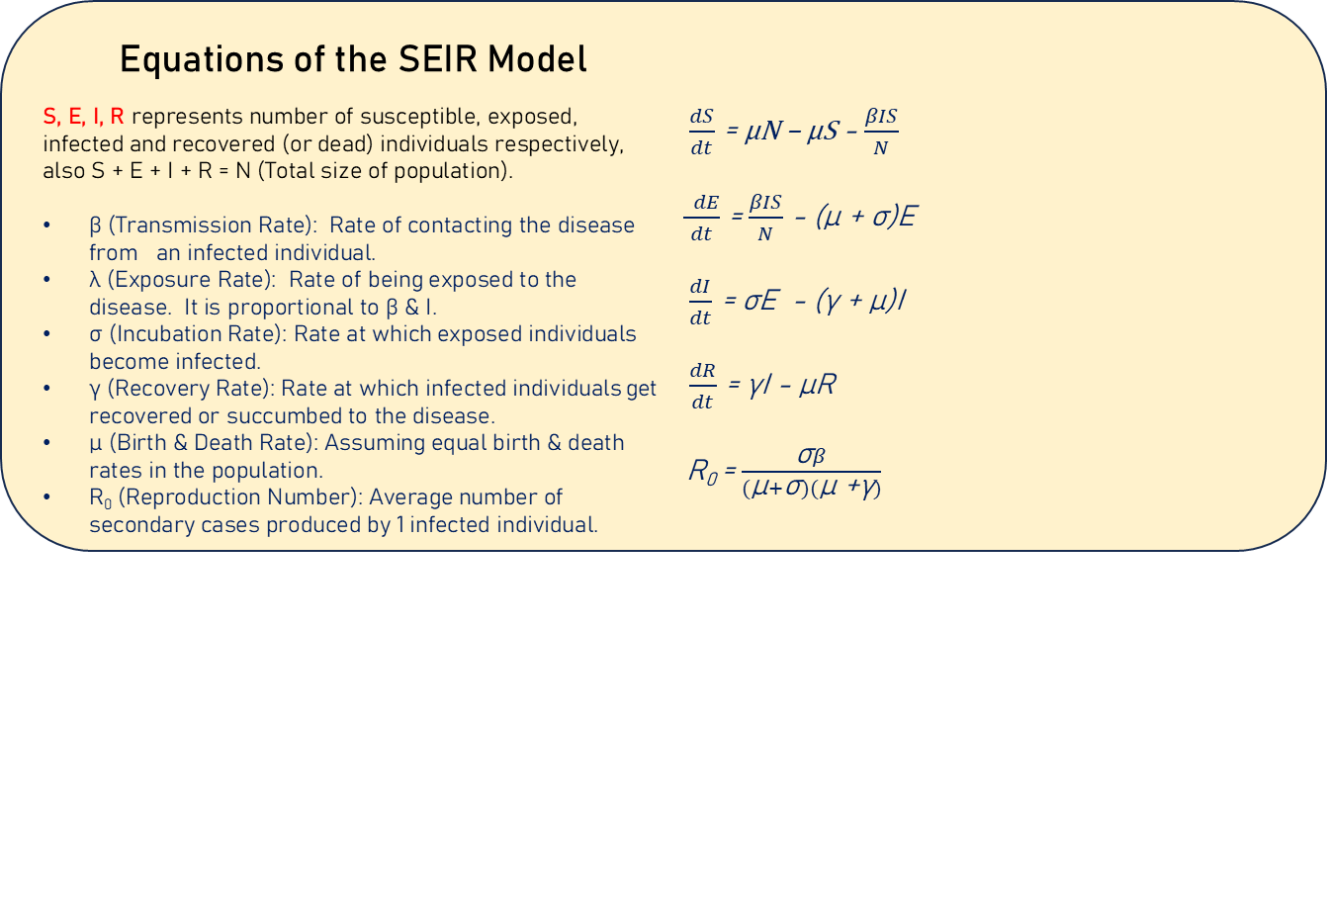
K. J. Somaiya school of Engineering, Mumbai – 400077
Department of Science and Humanities
F.Y. B. Tech. Semester –I (2024-25)
Applied Mathematics-I
IA-II
NAME : RAJAT KUMAR
ROLL NO.: 16014224054
DIV: C5 BATCH: C5-3
What are Epidemic Models ?
It is a mathematical model that helps to predict the outcome of any disease epidemic.
SEIR EPIDEMIC MODEL
Susceptible Individuals likely to contract the disease
Exposed
Individuals exposed but still not infectious
σ
Infected
Individuals that can infect others also
γ
Recovered
Individuals that gained immunity OR died
λ
How SEIR epidemic model works ?
It divides the population
into 4 categories based on their status w.r.t the disease & uses differential equations to predict the progression of the epidemic.
Equations of the SEIR Model
S, E, I, R represents number of susceptible, exposed, infected and recovered (or dead) individuals respectively, also S + E + I + R = N (Total size of population).
β (Transmission Rate): Rate of contacting the disease from an infected individual.
λ (Exposure Rate): Rate of being exposed to the disease. It is proportional to β & I.
σ (Incubation Rate): Rate at which exposed individuals become infected.
γ (Recovery Rate): Rate at which infected individuals get recovered or succumbed to the disease.
μ (Birth & Death Rate): Assuming equal birth & death rates in the population.
R₀ (Reproduction Number): Average number of secondary cases produced by 1 infected individual.
$\frac{dS}{dt}$ = μN – μS - $\frac{βIS}{N}$
$\frac{ dE}{dt}$ = $\frac{βIS}{N}$ - (μ + σ)E
$\frac{dI}{dt}$ = σE - (γ + μ)I
$\frac{dR}{dt}$ = γI - μR
R₀ = $\frac{\text{σ}β}{(\text{μ}+\text{σ})(\text{μ}\text{ +}\text{γ})}$
< 1
R₀
> 1
No Outbreak
Epidemic Outbreak
References
https://en.wikipedia.org/wiki/Compartmental_models_in_epidemiology
https://docs.idmod.org/projects/emod-generic/en/latest/model-seir.html
https://web.pdx.edu/~gjay/teaching/mth271_2020/html/09_SEIR_model.html
Date: 15-11-2024

